Slide 1
Analog Circuits and Systems
Prof. K Radhakrishna Rao
Lecture 14:
Dynamic Behavior of Feedback Systems

Slide 2
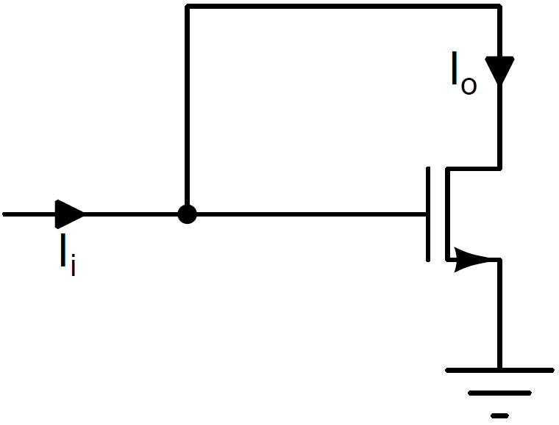
Current Follower using MOSFET
Common-gate amplifier
is valid within the active region of the n-channel enhancement MOSFET
Active region: 0 to I_{Dmax}

Slide 3
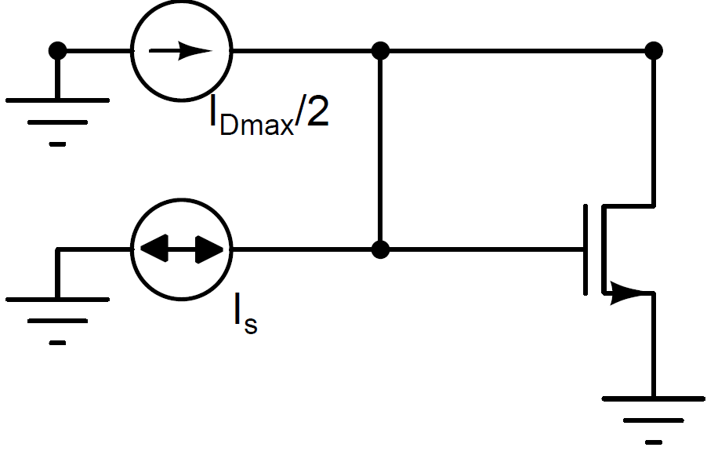
Current Follower using MOSFET (Biasing)
If the dynamic range is to be maximized
the MOSFET has to be biased at quiescent current of

Slide 4
MOSFET Current Follower as First-Order System
If the gate-to-source capacitance is taken into consideration

Slide 5
MOSFET Current Follower as First-Order System (contd.,)

Slide 6
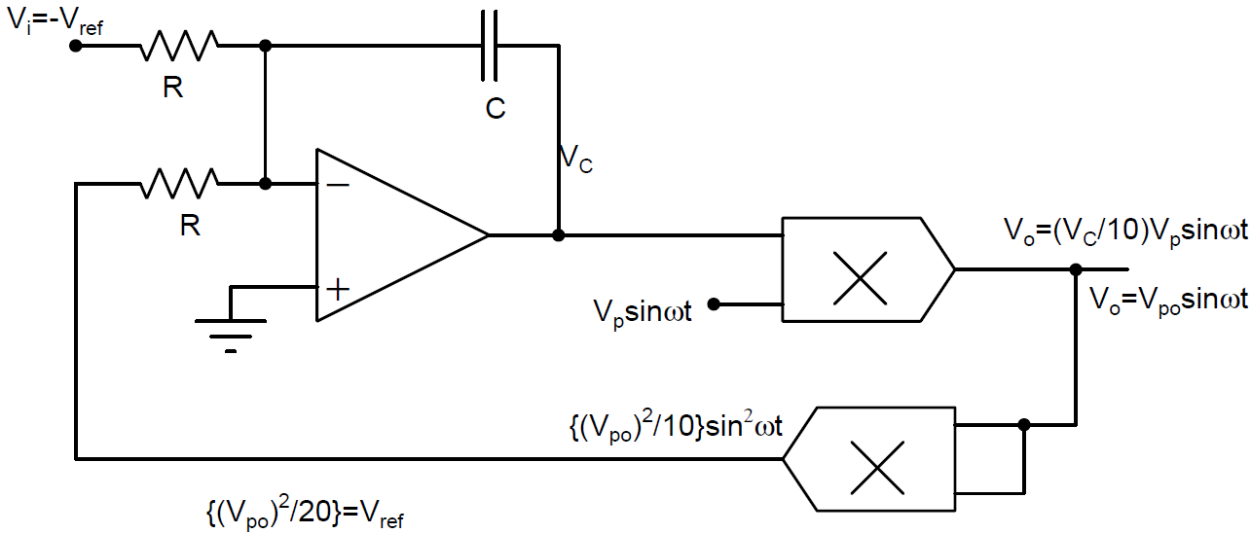
Automatic Gain Controller (Dynamic Behavior)

Slide 7
Automatic Gain Controller (Dynamic Behavior) (contd.,)
It is a dc voltage follower from V_{i} to the output of the squarer

Slide 8
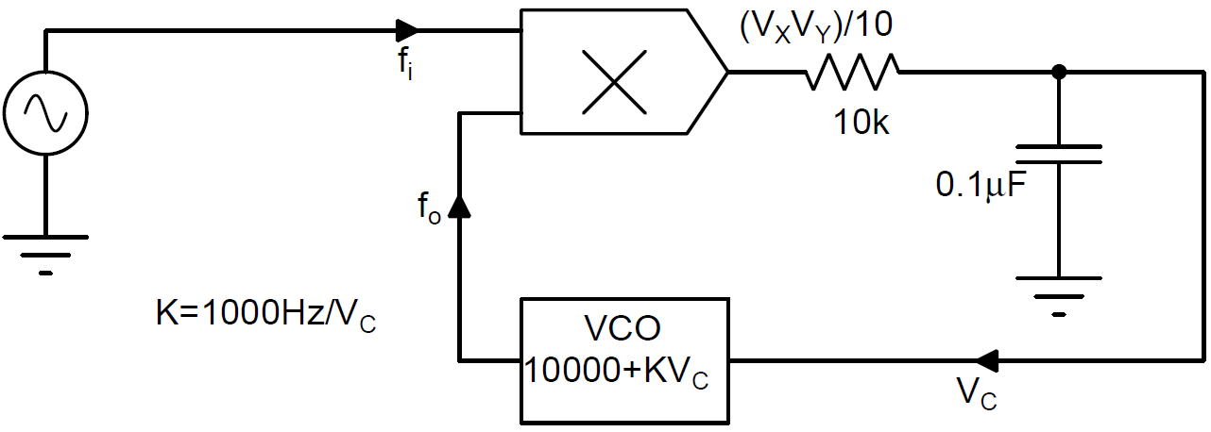
Frequency Follower

Slide 9
Frequency Follower (contd.,)

Slide 10
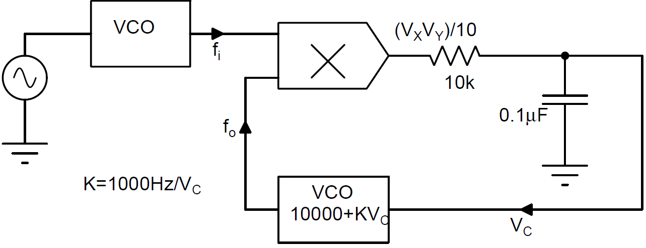
FSK Dynamics

Slide 11
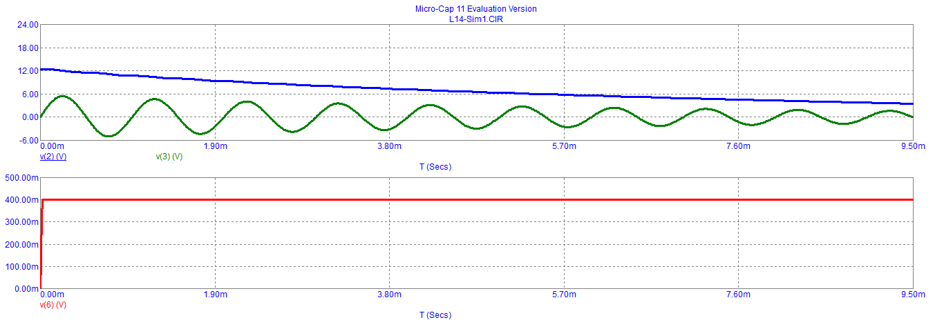
Simulation 1

Slide 12
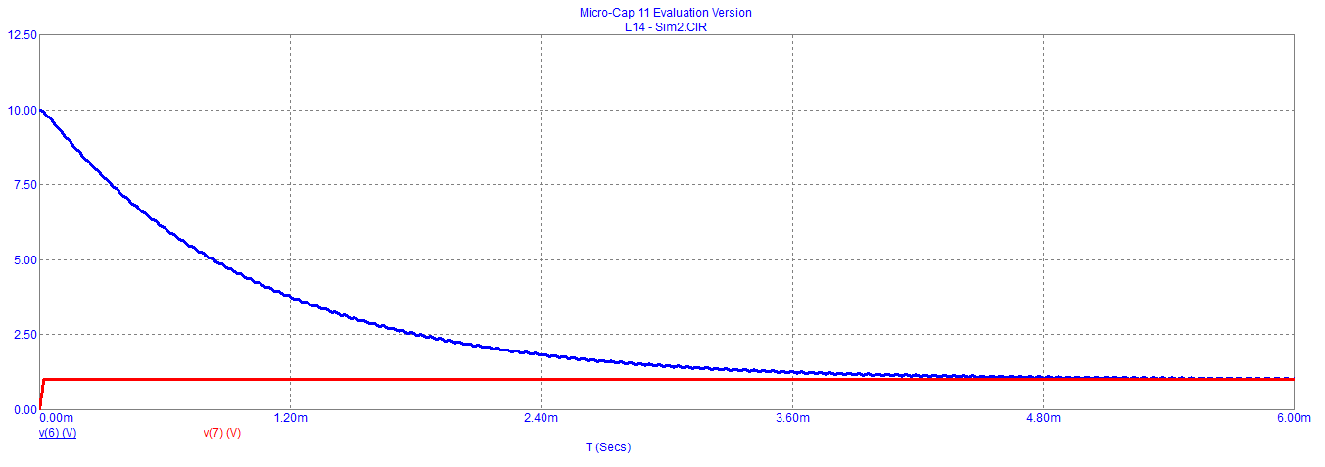
Simulation 2

Slide 13
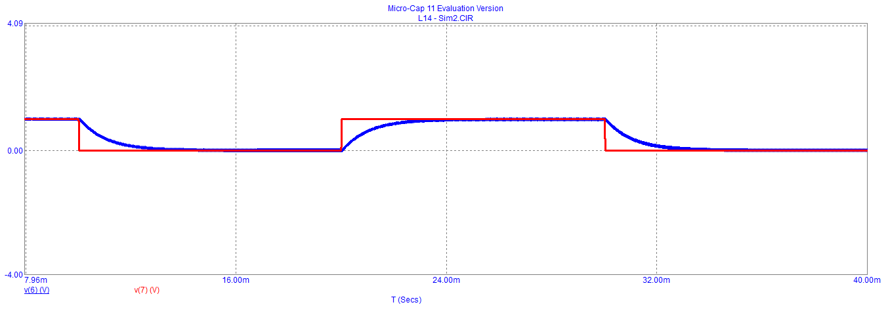
Simulation 3

Slide 14
Second Order System

Slide 15
Second Order System (contd.,)

Slide 16
Second Order System (contd.,)

Slide 17
Second Order System (contd.,)

Slide 18
Second Order System: Time Response
Input – output relationship in time domain of this second order feedback system is governed by

Slide 19
Second Order System: Time Response (contd.,)

Slide 20
Second Order System: Time Response (contd.,)

Slide 21
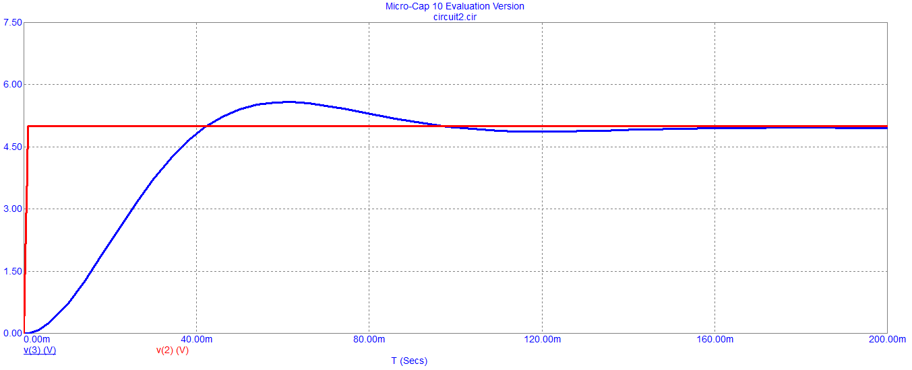
Simulation (Q=1)

Slide 22
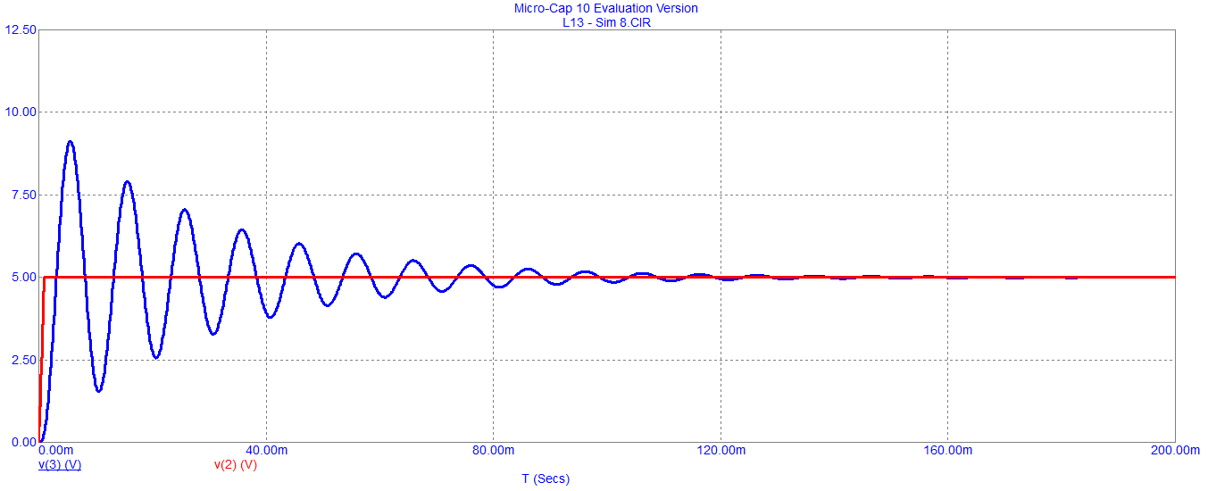
Simulation (Q=10)

Slide 23
Second Order System: Time Response (contd.,)

Slide 24
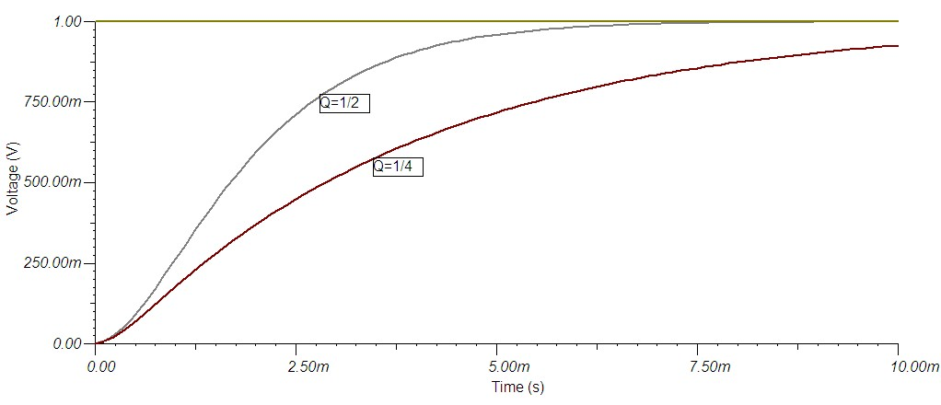
Step response of the second order system

Slide 25
Second Order System: Time Response (contd.,)
If Q<1 the rate of rise is lower.
When Q>1 the rate of rise is higher but there will be more peaks and results in higher settling time.
There are ten visible peaks (count up to 0.1 of the first peak) when Q = 10.
This can be generalized to say if Q = n, there will be n visible peaks in the transient response.
The most desirable step response of a feedback is obtained for a value of Q=1.
The response is characterized by good rate of rise with one small peak

Slide 26
Second Order System: Frequency Response

Slide 27
Second Order System: Frequency Response

Slide 28
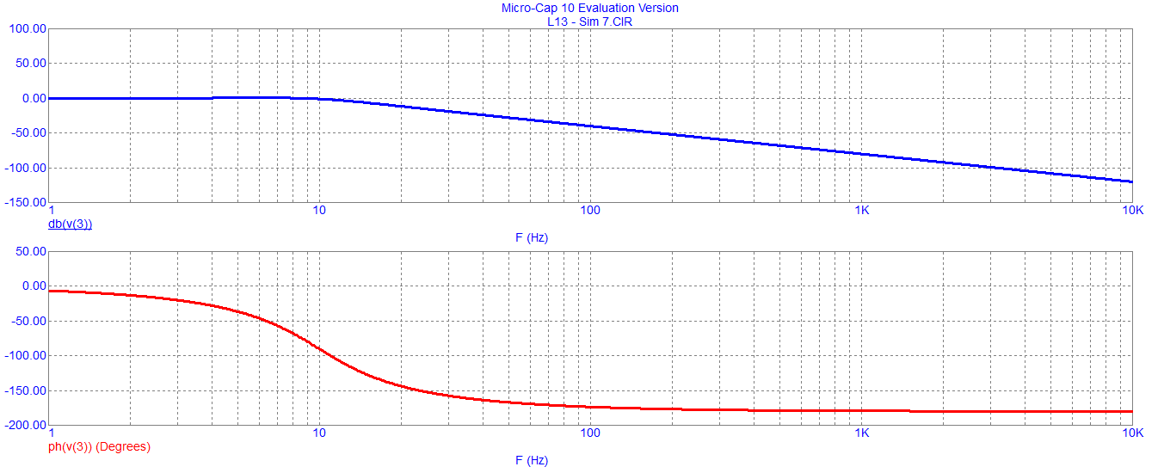
Frequency response of the second order system
Frequency response of the second order system with feedback Q=1

Slide 29
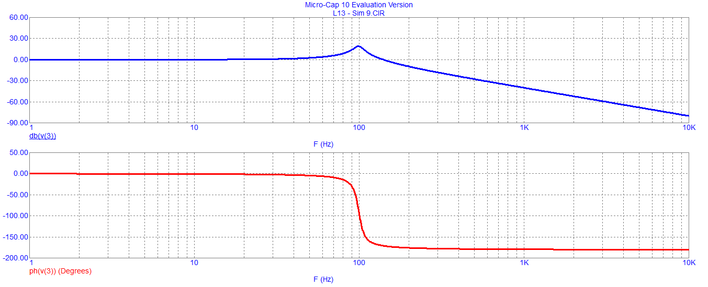
Frequency response of the second order system (contd.,)
Frequency response of the second order system with feedback Q = 10

Slide 30
Frequency response of the second order system (contd.,)
When G_{fmax}=G_{f0} then the frequency response of the amplifier is said to be maximally flat.
This property can be exploited in the design of wide band amplifiers

Slide 31
FLL – as second order system

Slide 32
Frequency Follower

Slide 33
Example 1

Slide 34
Example 2

Slide 35
Approximation of a Second Order System
Second order feedback amplifiers can be approximated to a first order system when
Q is much less than 1/2
Consider

Slide 36
Approximation of a Second Order System (contd.,)
G_{f} is now a first order system with bandwidth

Slide 37
Approximation of a Second Order System (contd.,)

Slide 38
Approximation of a Second Order System (contd.,)

Slide 39
Approximation of a Second Order System (contd.,)
As Q is much less than 1 the transient response of the amplifier is very sluggish and not satisfactory.
In order to increase Q to 1, f’ need to be shifted from 4 Hz to 400 Hz. This will increase GB to

Slide 40
Second order system with a zero
Transfer function of the feedback system

Slide 41
Second order system with a zero (contd.,)

Slide 42
Second order system with a zero (contd.,)
If ω_{z} is made equal to natural frequency of the second order system then Q = 1
Making Q = 1 is known as frequency compensation

Slide 43
Conclusion
Higher (third or higher) order systems are likely to become unstable when feedback is used.
Design of feedback systems should attempt to reduce the order of the system to second or first order. This is what we mean by frequency compensation of a feedback system
If of the subsystems of the feedback loop gets in saturation the feedback loop gets broken. Special arrangements may have to be made to bring the loop into active region.

